Slide 1
Who Is Attacking You? Distinguishing Motivation to Prioritize Threats
John Hultquist
Senior Manager, Cyber Espionage Threat Intelligence
iSIGHT Partners

Slide 2
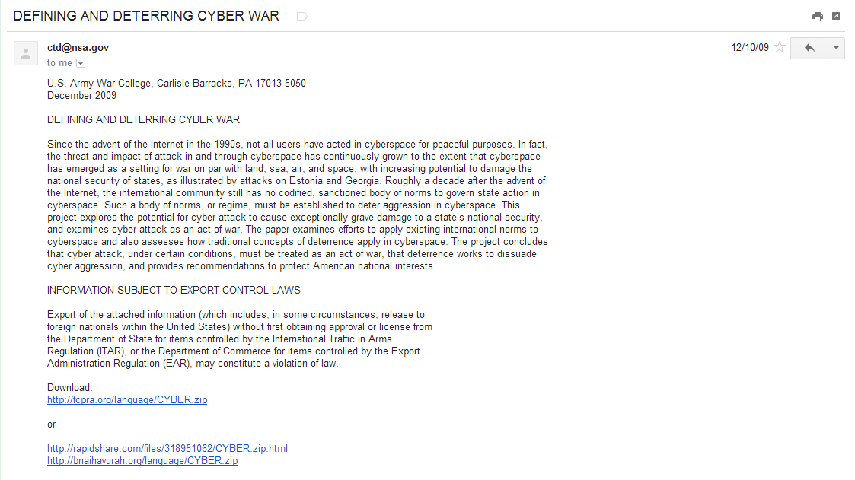
Just another Zeus?

Slide 3
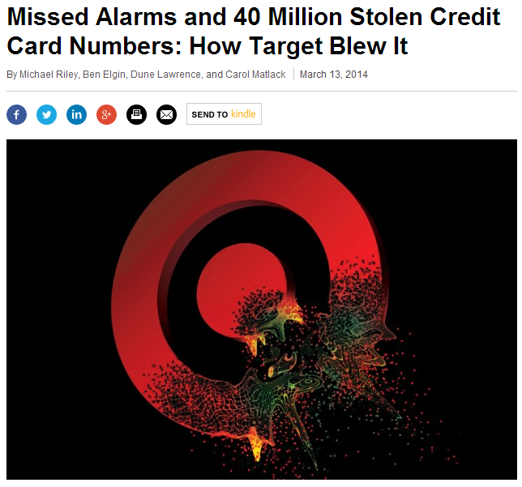
Who Cares?
Limited resources
  Thousands of events a day
  Security budgets are a cost center
  Noone cares about your non-contextualized “incidents”
  Not all incidents are the same
  Tough choices are inevitable
Bloomberg

Slide 4
Who Cares?
Security priorities should reflect differences in organizations
Two distinguishing features of organization
  Likelihood of being targeted
    Intellectual property
    Access to commodity data
    Access to strategic information
    Antagonistic relationships
    High-value interactions (negotiations, mergers and acquisitions)
  Relevance of effects on an organization
    Loss of competitive advantage
      Strategic: Research and development
      Tactical: Negotiations
    Brand damage
    Customer confidence
    Donor or investor confidence

Slide 5



Who Cares?
Global
Nongovernmental
Organization
Microchip Manufacturer
Consumer Retail
Strong intellectual property
No brand or public antagonism
Regular high-value negotiations
High-profile valuable brand
Steward of commodity financial data
Antagonistic relationship with labor
Popular; few antagonists
Heavily involved in geopolitics
Steward of donor information
Cyber Espionage
Cybercrime
Hacktivism
Cyber Espionage
Cybercrime

Slide 6



Who?
Cybercrime
Cyber Espionage
Hacktivism
Continuous threat activity against consumers and enterprises; criminals seeking personal information for financial gain.
Government-sponsored or affiliated actors and groups seeking intelligence and intellectual property.
Actors motivated by ideology, reputation and ego. Attacks often triggered by corporate and political actions, major news events, etc.

Slide 7
The Cybercrime Threat
Noisiest realm for the enterprise
Two types of theats
  Opportunistic
  Targeted
Market-driven
  Scalability and Efficiency
  Opportunities for niche sales
  Aftermarket
Cybercriminal Intent:
Compromise
Exfiltrate
Maintain Access
Enable Fraud
Disrupt

Slide 8
The Hacktivist Threat
Motivated by “isms”
  Nationalism, Religion, Ethnicity, Environment
  Ego
Overt
  Advance threats
  Open communications
  Overt endgame
Hacktivist Intent:
Compromise
Exfiltrate
Destroy
Disrupt
Dump
Deface
Embarrass

Slide 9
The Cyber Espionage Threat
Gentleman Spy
  Covert
  Often distinguished by the lack of visible outcomes
  At least he won’t embarrass you.
aPT?
Rarely employing sophisticated deception
Regularly betray their interests
Cyber Espionage Intent:
Compromise
Exfiltrate
Maintain Access
Enable Information Advantage

Slide 10





A Note on Attribution
Key to self-assessment, external collection, and warning
If you can attribute to a known group, and you know there MO, you are ahead of the game
History is the most important insight
Actor
Sender
Code
C2

Slide 11
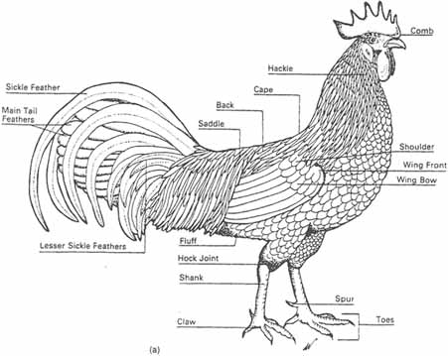
Distinguishing Features
History
Actions on Objective
Targeting
Malware Capability
Exploits
Infrastructure

Slide 12
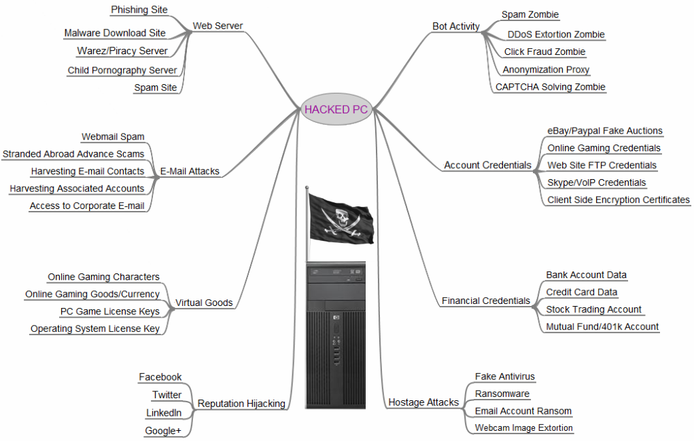

Actions on Objective
Persistence over time
  CE intrusions are measured in years
  Cybercrime intrusions measured in months
  Hacktivist intrusion measured in days
Type of information collected
  Documents and emails
  Commodity financial data
Krebs

Slide 13
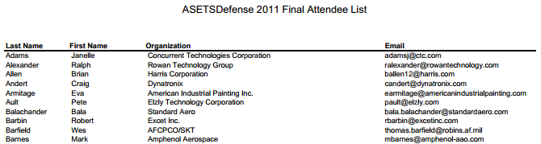
Targeting
Function or role of targeted personnel
Source and exclusivity of target information
Social engineering
Watering hole choices

Slide 14
Targeting

Slide 15

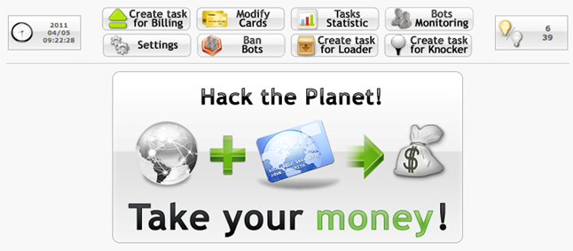
Malware
Historical use of malware
  Limited value
Propagation and access to malware
  Exclusivity is hard to measure
Malware functionality
  Document and CAD exfiltration
  Financial credential harvesting
Exploits
  Zero-days are not only the realm of CE

Slide 16
Infrastructure
DGA and fastflux techniques are most often used in large-scale criminal campaigns
Targeting may be present in domains or senders
  Consillium.proxydns.com
  Unhq.dynssl.com
  Voanews.proxynews.com
  Secretariat.lukash@gmail.com
  Kulkov.bric@gmail.com
Actor
Sender
Code
C2

Slide 17

Making sense of the data points
Not an engineering/math problem
Work with imperfect data
Ultimately produce a judgment
  High confidence
  Medium confidence
  Low confidence
Analysis of competing hypothesis can help us judge between adversary motivations

Slide 18
Analysis of Competing Hypothesis
Evidence | Cyber Espionage | Cybercrime | Hacktivism
No data dumping event | Consistent | Consistent | Highly Inconsistent
Zeus malware available through marketplace | Neutral | Neutral | Neutral
Government social engineering | Highly Consistent | Inconsistent | Consistent
No specific targeting for fraud | Consistent | Inconsistent | Consistent
Multiple year duration | Consistent | Inconsistent | Consistent
Extra document exfiltration capability | Consistent | Inconsistent | Consistent
Targets acquired through Stratfor, TRC | Highly Consistent | Consistent | Consistent

Slide 19
Questions
jhultquist@isightpartners.com

